Slide 1
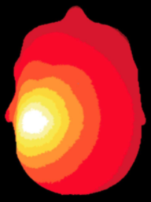
NeuroDOT
Tutorial:
Generating a Light Model

Slide 2
NeuroDOT Set-Up - Checklist
Before starting any tutorial, please make sure you’ve done the following
Download the appropriate versions of matlab, neuroDOT, and NIRFAST
Matlab: 2020b
NeuroDOT toolbox from NITRC
https://www.nitrc.org/projects/neurodot/
NIRFASTer-master
https://github.com/nirfaster/NIRFASTer
Set your path so that all required folders and subfolders are included
Folders w/subfolders to include
NeuroDOT toolbox
NIRFASTer-master
Your personal directory
Folders to include
Output directory

Slide 3


NeuroDOT Set-Up – Output Directory
Example output directory
Once you’ve set your path, the next thing you should do is set your output directory.
The output directory must be located within your path
If it isn’t already in your path, you must add it to your path
You can set your own path to an output directory in the line shown above
An output directory specifies the location where files will be saved
MATLAB, by default, will save files to the current directory
The following line of code will change your current directory to the output directory that you just specified →
Now you can save outputs directly to your output directory

Slide 4
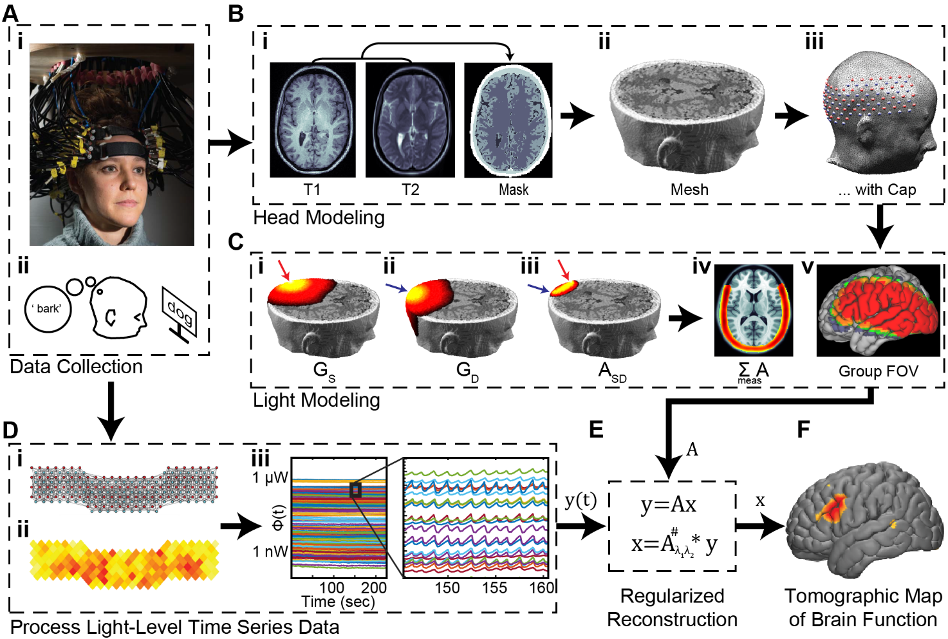
Diffuse Optical Tomography
In diffuse optical tomography (DOT), arrays of optical sources and detectors are used to perform functional neuroimaging experiments on task-based or resting state modes of human brain function.
Analyses are broken into several pipelines:
B: modeling of the tissue shape, optical property distribution, and source/detector locations
C: modeling of the light emission, diffusion, and detection through the head
D: preprocessing of the raw source-detector measurements
E: reconstruction and spectroscopy of the preprocessed data and light model into a functional neuroimaging volume
F: post-processing analysis of these results.

Slide 5
Light Modeling Tutorials in NeuroDOT
NeuroDOT has several different tutorials that detail how to Generate a Light Model, each with its own purpose. They’re listed below to help you figure out which version is the best for your purposes.
Basic Light Modeling Tutorial with AlignMe
PPT: NeuroDOT_Tutorial_Generating_a_Light_Model_Pad_24x28_With_AlignMe
Script: Basic_Light_Modeling_with_AlignMe_Tutorial
Pad file: Pad_AdultV24x28.mat
Sparse Pad Tutorial with AlignMe
PPT: NeuroDOT_Tutorial_Generating_a_Light_Model_SparsePad_32x32_With_AlignMe
Script: Basic_Light_Modeling_with_sparse_Pad_and_AlignMe_Tutorial
Pad file: Pad_FullHead_32x32.mat
Light Modeling with a Subset of Measurements
PPT: NeuroDOT_Tutorial_Generating_a_Light_Model_With_Subset_of_Measurements_Pad_24x28_and_AlignMe
Script: Light_Modeling_with_Subset_of_Measurements_and_AlignMe_Tutorial
Pad file: Pad_AdultV24x28.mat
Split Pad Tutorial
PPT: NeuroDOT_Tutorial_Split_Pad_Light_Modeling_With_LUMO_Adult_Temporal_Pad_and_AlignMe
Script: Split_Pad_Light_Modeling_with_LUMO_Adult_Temporal_Pad_and_AlignMe_Tutorial
Pad file: LUMO_adult_temporal_pad.mat
Basic Light Modeling with Hummingbird
PPT: NeuroDOT_Tutorial_Generating_a_Light_Model_Pad_24x28_With_Hummingbird
Script: Basic_Light_Modeling_with_Hummingbird_Tutorial
Pad file: Pad_AdultV24x28.mat
Sparse Pad Tutorial with Hummingbird
PPT: NeuroDOT_Tutorial_Generating_a_Light_Model_SparsePad_32x32_With_Hummingbird
Script: Basic_Light_Modeling_with_sparse_Pad_and_Hummingbird_Tutorial
Pad file: Pad_FullHead_32x32.mat
Light Modeling with Adult 96x92 Pad
PPT: NeuroDOT_Tutorial_Generating_a_Light_Model_Pad_Adult_96x92_Example
Script: Basic_Light_Modeling_with_AlignMe_Tutorial_Pad_Adult_96x92
Pad file: Pad_Adult_96x92.mat
Note: this tutorial’s PowerPoint is in an older style

Slide 6
Generating a Light Model
This tutorial will follow the Basic_Light_Modeling_with_Hummingbird_Tutorial.m Matlab file which can be found in the Documentation/Scripts folder.
The tutorial will:
Generate a mesh from a segmented volume
Place an array of sources and detectors on the mesh
Set multiple parameters for the model
Calculate the sensitivity A for this model
We will use a segmented volume, Segmented_MNI152nl_on_MNI111, found in Support_Files/Atlases, to generate the head model.
We will use the visual pad, Pad_AdultV24x28.mat, found in Support_Files/Pad.

Slide 7
NeuroDOT Flowchart for Light Model Generation
MRI Acquisition
Image Segmentation
Mesh Generation
These steps are repeated for a low-density and high-density mesh
Optode Placement
Calculate Sensitivity
Validate Sensitivity

Slide 8
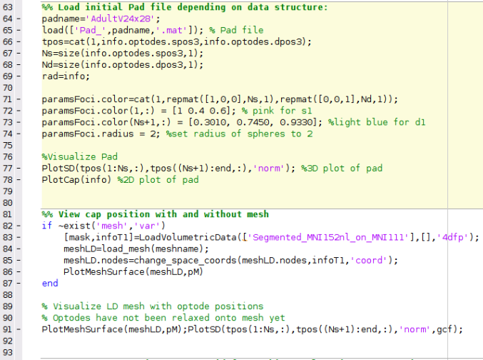
Running the script – Author’s Note
How the author runs the script
Highlight and execute each chunk of code
Ex: highlight lines 64-69 → right click → hit “Evaluate Selection”
Alternate way of running the script
For each section (beige) hit ctrl+enter
This isn’t how the author does it, but it will still work
Note: DO NOT HIT THE GREEN “RUN” BUTTON to run this script
MATLAB versions to use
Optimal version: MATLAB 2020b
The version that AlignMe was developed in
NIRFAST version to use
NIRFASTer, the newest release of NIRFAST
Found here: https://github.com/nirfaster/NIRFASTer
Example
section

Slide 9
NeuroDOT Set-Up – In Script
The first section of code in this script will have you set your output directory and allow you to navigate to your desired output directory from within the script
Some parameters for visualizations made in the script are set up here as well
23.
24.
25.
26.
28.
29.
30.
31.
%Set Output Directory
%Change the path on the following line to whatever output directory you want to use
outputdir = ‘’; % put path to directory in between quotes
cd(outputdir)
%Parameter Initialization
p.Cmap='jet'; p.Scale=5; p.Th.P=0; p.Th.N=-p.Th.P; p.PD=1; p.BG=[0,0,0];
pM.orientation='coord'; pM.Cmap.P='gray'; pM.EdgeColor='none';
pS = pM; pS = rmfield(pS, 'orientation'); % make copy of params, to be used with PlotSlices

Slide 10
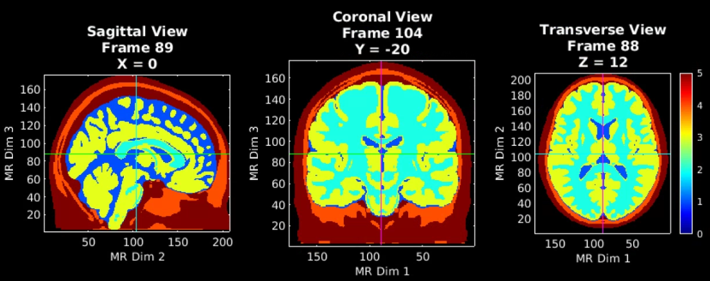
Load a Segmented volume and visualize
MRI Acquisition
Image Segmentation
35.
36.
[mask,infoT1]=LoadVolumetricData(['Segmented_MNI152nl_on_MNI111_nifti'],[],’nii');
PlotSlices(mask,infoT1,p) % Visualize the segmented mask
Note that PlotSlices.m generates an interactive visualization of the volume. Simply press ‘q’ or the middle mouse button to release the figure.
5 – Scalp
4 – Skull
3 – Gray Matter
2 – White Matter
1 – CSF
0 - Background

Slide 11
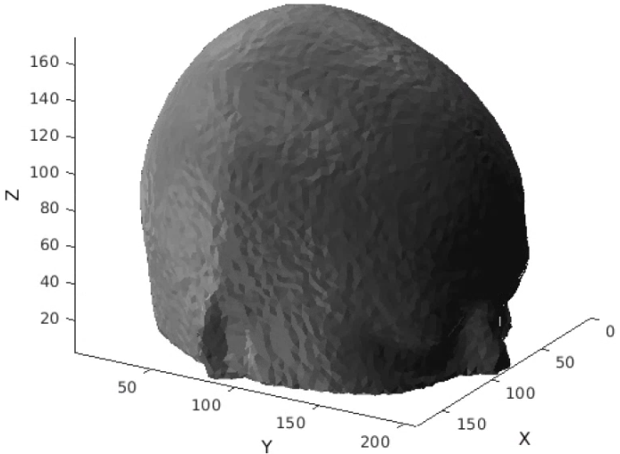
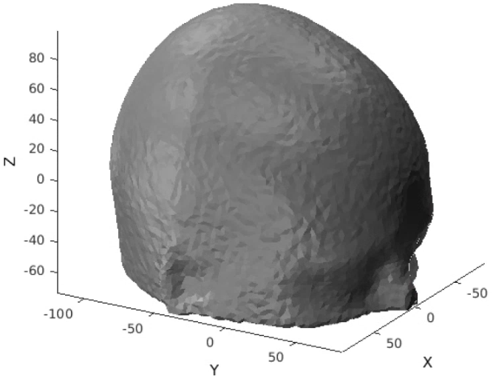
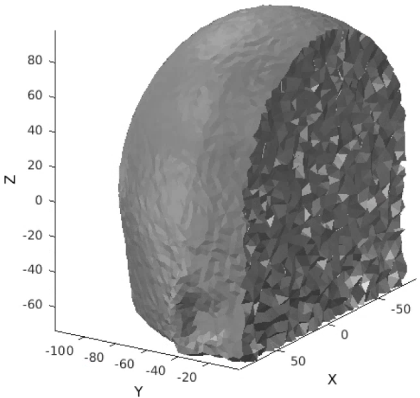
Generate a low-density mesh and visualize
MRI Acquisition
The low-density mesh will be used to efficiently align the optical array to its position on the head
% Parameters for generating your mesh
meshname=[‘LD_Mesh']; % Provide a name for your mesh name here
param.facet_distance=5; % Node position error tolerance at boundary
param.facet_size=3; % boundary element size parameter
param.cell_size=5; % Volume element size parameter
param.info=infoT1;
param.Offset=[0,0,0];
param.r0=5;
param.CheckMeshQuality=0;
param.Mode=1;
tic;meshLD=NirfastMesh_Region(mask,meshname,param);toc
Parameters of note
facet_distance: error tolerance at boundary for node positions
facet_size: size of surface triangles
cell_size: size of internal tetrahedra
This can be changed to ensure that the total number of nodes in the mesh does not exceed 999,999
Mode: controls density of mesh, 1 for low density, 0 for high density
Image Segmentation
43.
44.
45.
46.
47.
48.
49.
50.
51.
52.
53.
LD Mesh Generation
“index space”
is non-negative
“coordinate space”
The origin is in the center of volume
A view inside
Run lines 54-74 to generate visualizations

Slide 12
Atlas vs Subject Specific LD Mesh Generation
MRI Acquisition
Depending on your starting volume, the low-density mesh generation process will differ
Atlas based mesh (what this tutorial does)
Set param.Offset = [0,0,0];
Then use change_space_coordinates()
Subject specific based mesh
Set param.Offset = InfoT1.center; (that’s it)
% Parameters for generating your mesh
meshname=[‘LD_Mesh']; % Provide a name for your mesh name here
param.facet_distance=5; % Node position error tolerance at boundary
param.facet_size=3; % boundary element size parameter
param.cell_size=5; % Volume element size parameter
param.info=infoT1;
param.Offset=[0,0,0];
param.r0=5;
param.CheckMeshQuality=0;
param.Mode=1;
tic;meshLD=NirfastMesh_Region(mask,meshname,param);toc
meshLD.nodes=change_space_coords(meshLD.nodes,infoT1,'coord’);
Image Segmentation
LD Mesh Generation
“coordinate space”
The origin is in the center of volume
“index space”
is non-negative

Slide 13
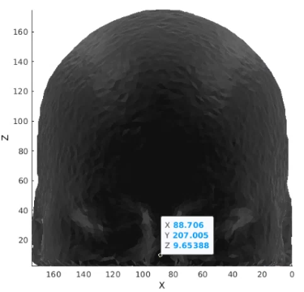
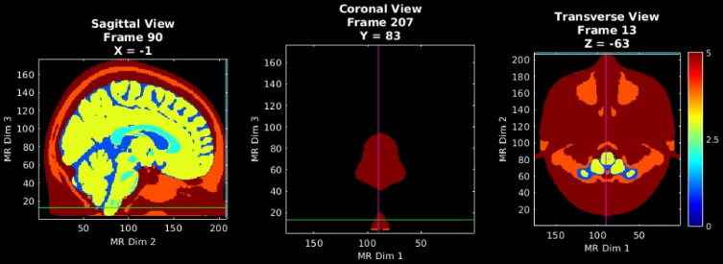
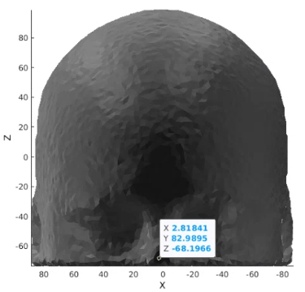
Validating LD Mesh Generation
MRI Acquisition
Make sure your mesh is in the same space as your volume
In PlotSlices, place crosshairs at the tip of the nose
Note the X, Y, and Z coordinates for those slices
Generate LD mesh with your chosen parameters
Param.Offset = [0,0,0]; or Param.Offset = infoT1;
Use change_space_coordinates() or don’t use it
In atlas figure, click on the tip of the nose of the mesh
Note the X, Y, and Z coordinates for those slices
Repeat the above 2 steps, with different parameters if the X, Y, Z coordinates are not similar
Image Segmentation
LD Mesh Generation
Atlas Volume
+
No CSC
Volume coords
X = -1
Y = 83
Z = -63
Atlas Volume
+
CSC
Coords are similar to volume!

Slide 14
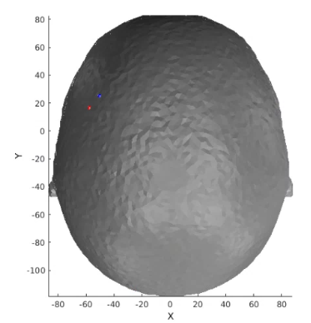
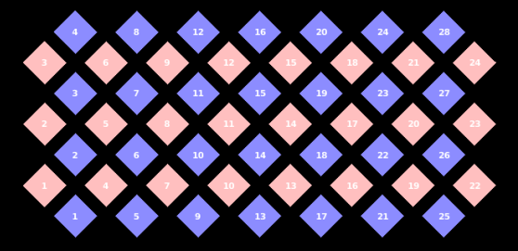
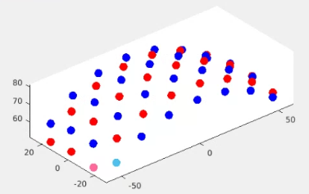
Place the optodes on the LD mesh
MRI Acquisition
Load in a Pad file for a grid design of interest, here we use the AdultV24x28 array
padname='AdultV24x28';
load(['Pad_',padname,'.mat']); % Pad file
tpos=cat(1,info.optodes.spos3,info.optodes.dpos3);
Ns=size(info.optodes.spos3,1);
Nd=size(info.optodes.dpos3,1);
rad=info;
paramsFoci.color=cat(1,repmat([1,0,0],Ns,1),repmat([0,0,1],Nd,1));
paramsFoci.color(1,:) = [1 0.4 0.6]; %pink for s1
paramsFoci.color(Ns+1,:) = [0.3010, 0.7450, 0.9330]; %light blue for d1
paramsFoci.radius = 2; %set radius of spheres to 2
Note: This Pad file is a starting point and may not align with the mesh right away.
80.
81.
82.
83.
84.
85.
87.
88.
89.
90.
93.
94.
98.
99.
Image Segmentation
LD Mesh Generation
Optode Placement
Draw_Foci_191203(tpos, paramsFoci);view([-40,30])
PlotCap(info)
PlotMeshSurface(meshLD,pM);Draw_Foci_191203(tpos, paramsFoci);
view([0,90])

Slide 15
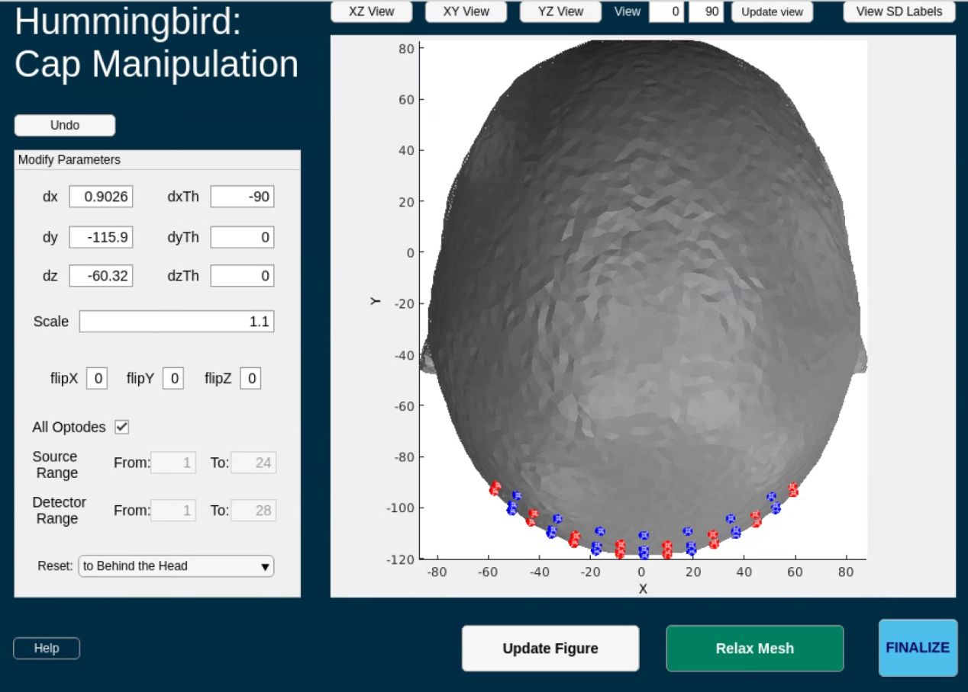
Place the optodes on the LD mesh
MRI Acquisition
Adjust array position via the Hummingbird App by altering parameters and re-visualizing mesh and array:
Image Segmentation
First, reset the grid position
Select: “to Behind the Head” from the drop down
The view will then update
Then, choose a view that will best show the location of the array relative to the mesh
XY view is great for this
Input new values for parameters and Update Figure
dx, dy, dz: translate the array
dxTh, dyTh, dzTh: rotate the array
Scale: size the array
flipX, flipY, flipZ: flip the array
Repeat until array is ~5mm off the head for the whole pad but is lined up with the mesh. After following the upcoming tutorial, the mesh and grid should look like the image on the right.
LD Mesh Generation
Optode Placement
Note: The following 15 slides are an in-depth tutorial on how to use the Hummingbird app

Slide 16
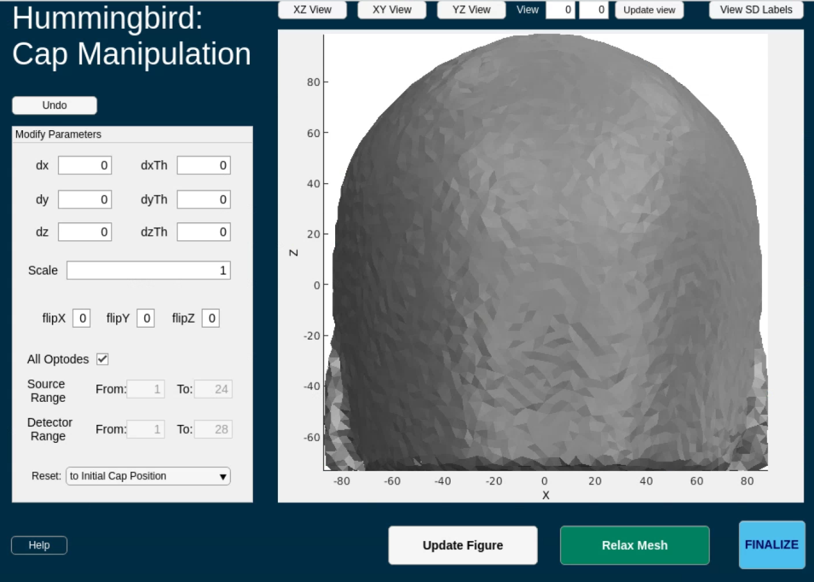
Hummingbird Tutorial 1
Run the following code to create the DataStorage class and open the Hummingbird app
ds = DataStorage();
% input structure
ds.dI.tpos = tpos;
ds.dI.mesh = meshLD;
ds.dI.pM = pM;
ds.dI.paramsFoci = paramsFoci;
ds.dI.Ns = Ns;
ds.dI.rad = rad;
myapp = Hummingbird(ds);
while isvalid(myapp); pause(0.1); end
Default view on Hummingbird launch

Slide 17
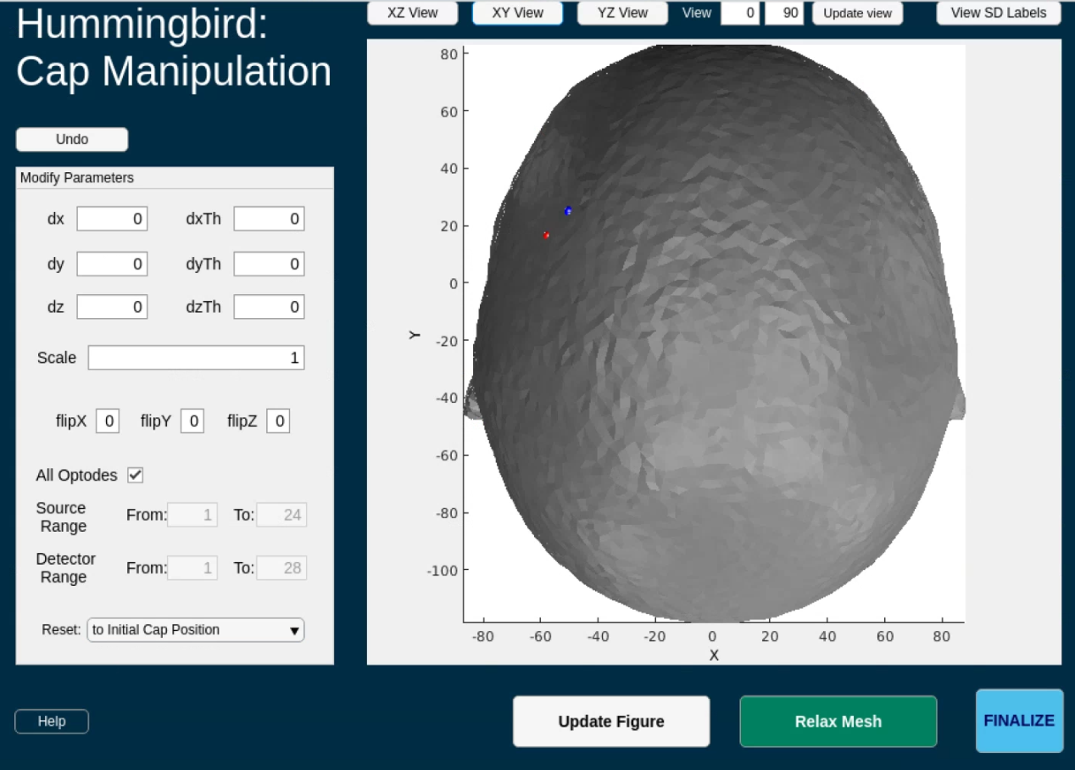
Hummingbird Tutorial 2
Change the view to locate the pad
The pad is the grid comprised of red and blue spheres
Sometimes the pad may be sitting inside of the mesh upon startup
Use XY view to start

Slide 18
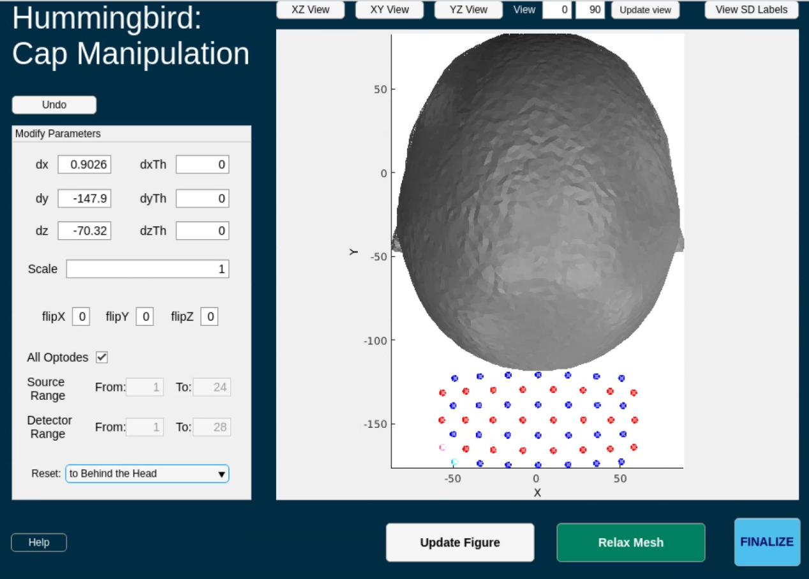
Hummingbird Tutorial 3
Reset the pad to behind the head to visualize it
This is a visual pad, and covers the occipital lobe and sits on the posterior surface of the mesh
Notice that the values changed for dx, dy, and dz
These are the changes in x, y, and z from the original position of the pad when Hummingbird was initialized
Let’s reset the view and begin to line up the mesh

Slide 19

Hummingbird Tutorial 4
Hit “XZ View” to return to the initial view, which covers the back of the mesh
Now, lets rotate the pad so we can line it up

Slide 20
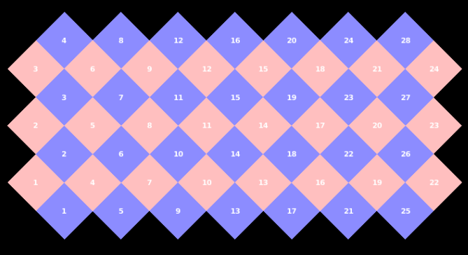
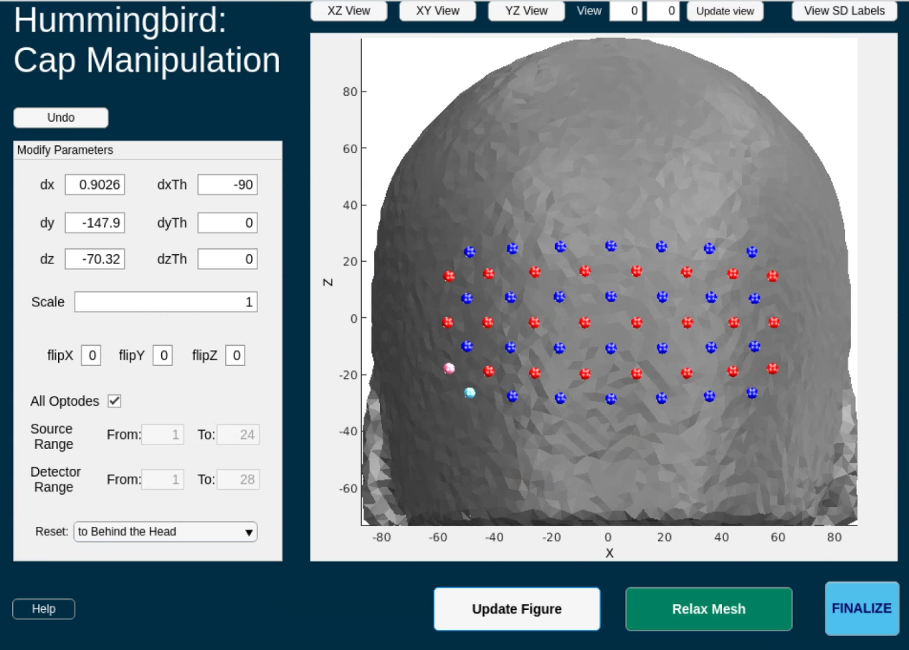
Hummingbird Tutorial 5
Rotate the pad by modifying, dxTh, dyTh, or dzTh with the angle IN DEGREES that you want to rotate the pad by
Here we rotated the pad around the x axis by 90 degrees, dxTh = -90
Hit “Update Figure” to update the grid’s orientation
The blue and pink sources and detectors on the pad correspond to S/D 1, you can check this with the pad layout visualization generated earlier in the script
Additionally, the “View SD Labels” button will switch the pad from spheres to SD numbers which makes verifying against the layout visualization easier

Slide 21

Hummingbird Tutorial 6
After hitting the “View SD Labels” button, the grid will show up as numbers instead of spheres
Also, the button will change to say “View SD Spheres”
The blue and pink sources and detectors on the pad correspond to S/D 1, you can check this with the pad layout visualization generated earlier in the script

Slide 22

Hummingbird Tutorial 7
Adjust the “Scale” to change the distance between optodes
Recommended Scale = 1.1
Hit “Update Figure” after setting the scale

Slide 23

Hummingbird Tutorial 8
The bottom row of optodes should line up with the very top of the ear.
Adjust “dz” to do this
Changed from -70.32 to -60.32
Hit “Update Figure” after adjusting dz

Slide 24
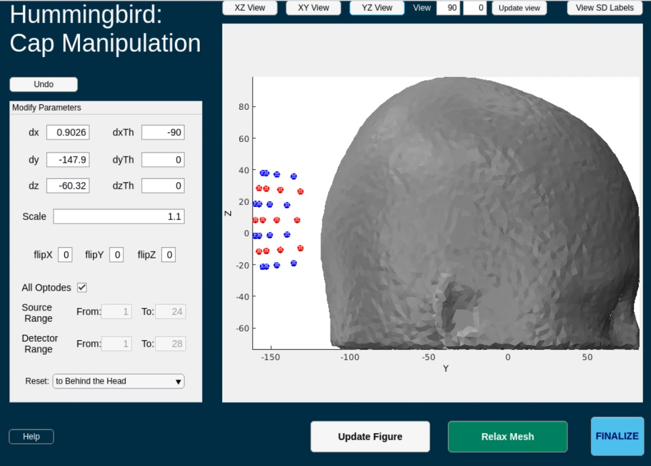
Hummingbird Tutorial 9
Change to “YZ view”
Visualization check
The pad should be no more than 10mm away from the mesh
Let’s move it closer

Slide 25
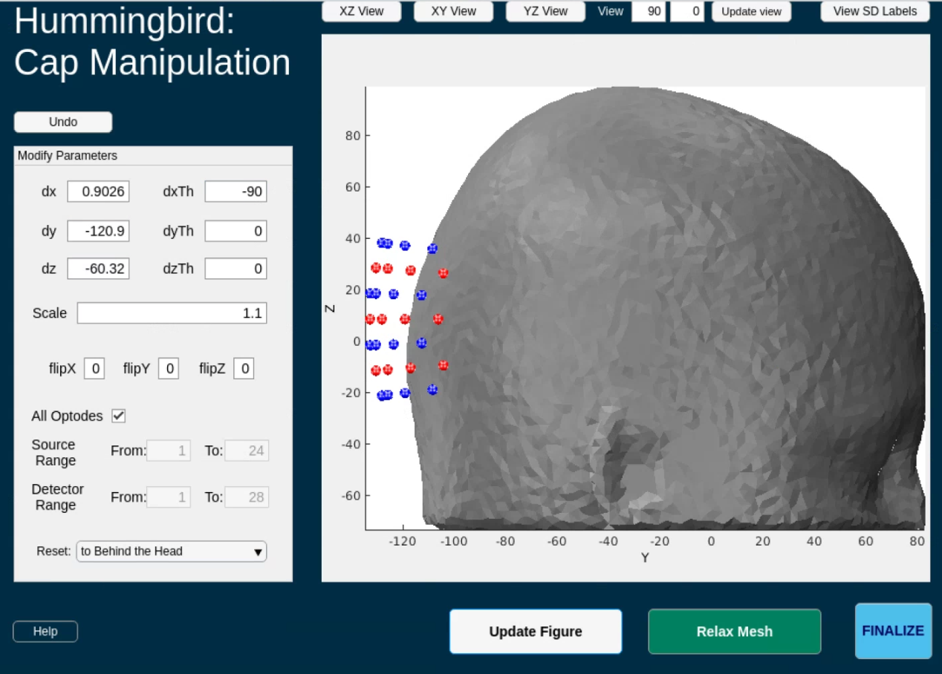
Hummingbird Tutorial 10
Visualization check
The pad should be no more than 10mm away from the mesh
Let’s move it closer
dy changed from -147.9 to -120.9
Remember to hit “Update Figure” after changing dy
Let’s visualize in XY view one more time to check the distance

Slide 26
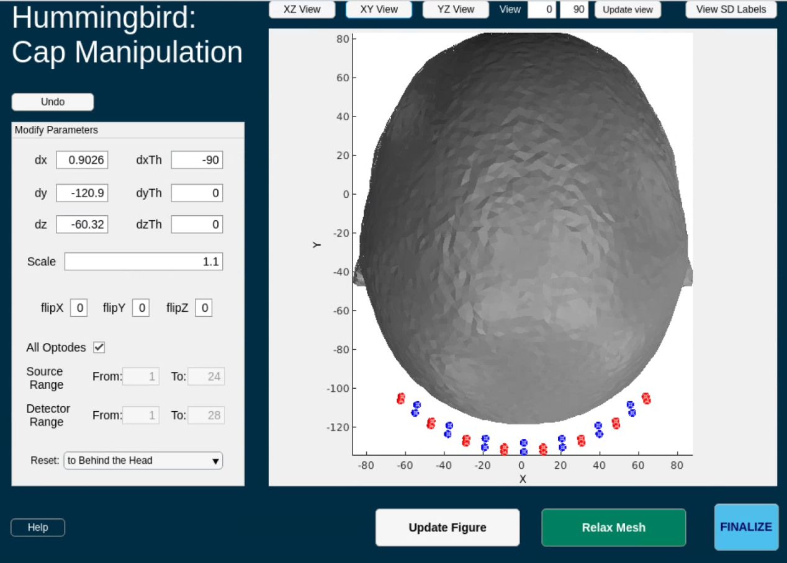
Hummingbird Tutorial 11
One last visualization check
Hit “XY View”
We can move the pad slightly closer. Let’s adjust “dy” one last time

Slide 27
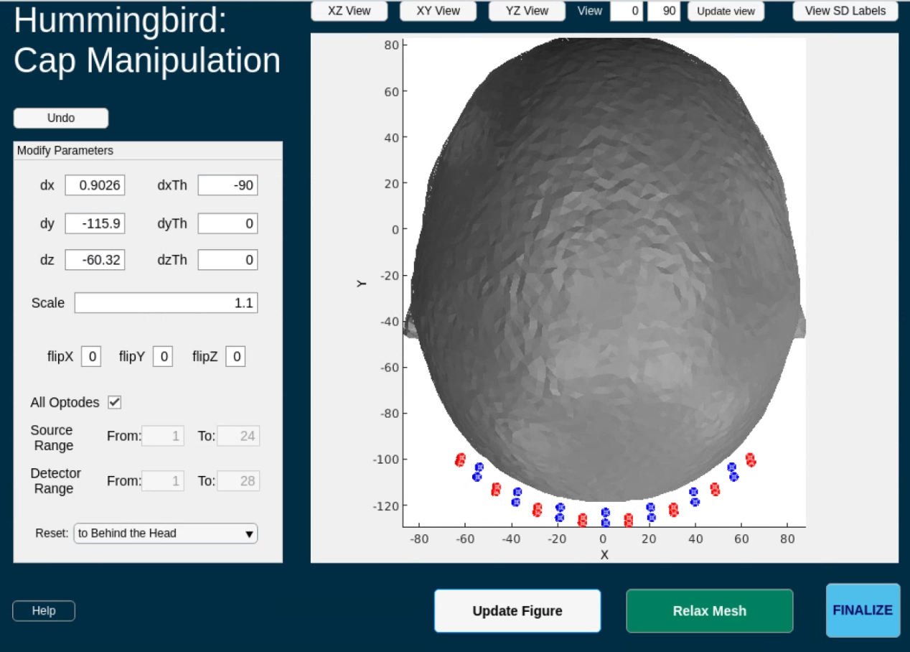
Hummingbird Tutorial 12
Dy changed from -120.9 to -115.9
Remember to hit “Update Figure” afterwards
Looks good! Now time to relax the grid onto the mesh
Hit the “Relax Mesh” button

Slide 28
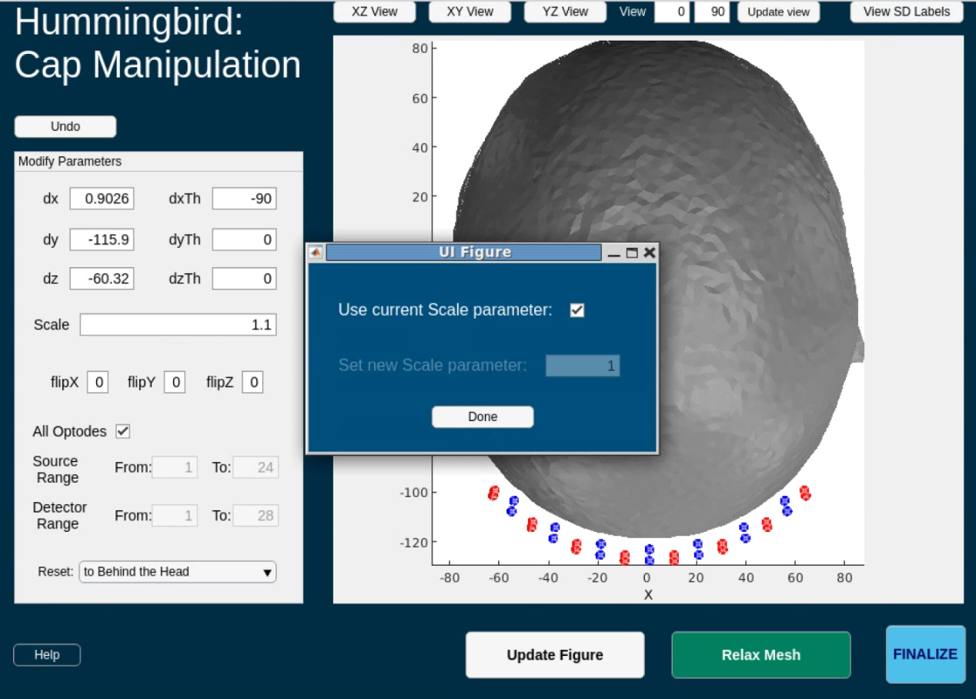
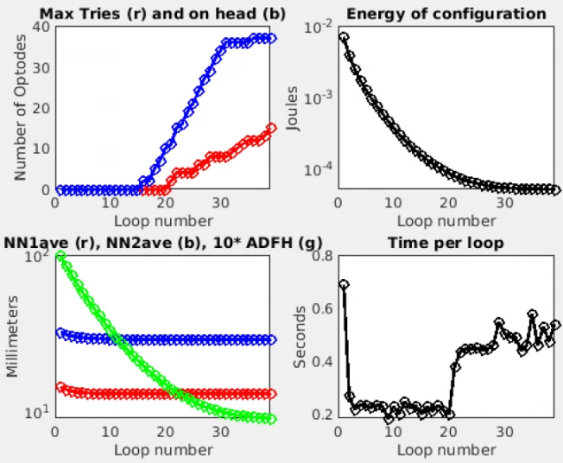
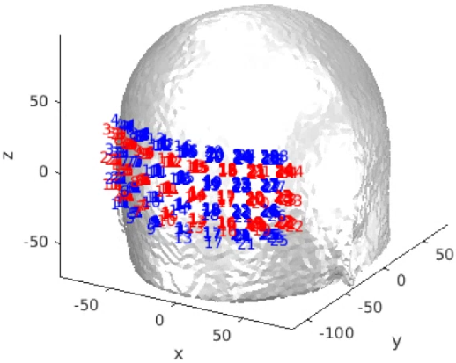
Hummingbird Tutorial 13
After hitting “Relax Mesh”, confirm that you want to use the current scale parameter
Current scale parameter = 1.1
After hitting “Done”, the below two figures will pop up and start to update
Hummingbird is now relaxing the optodes onto the mesh

Slide 29
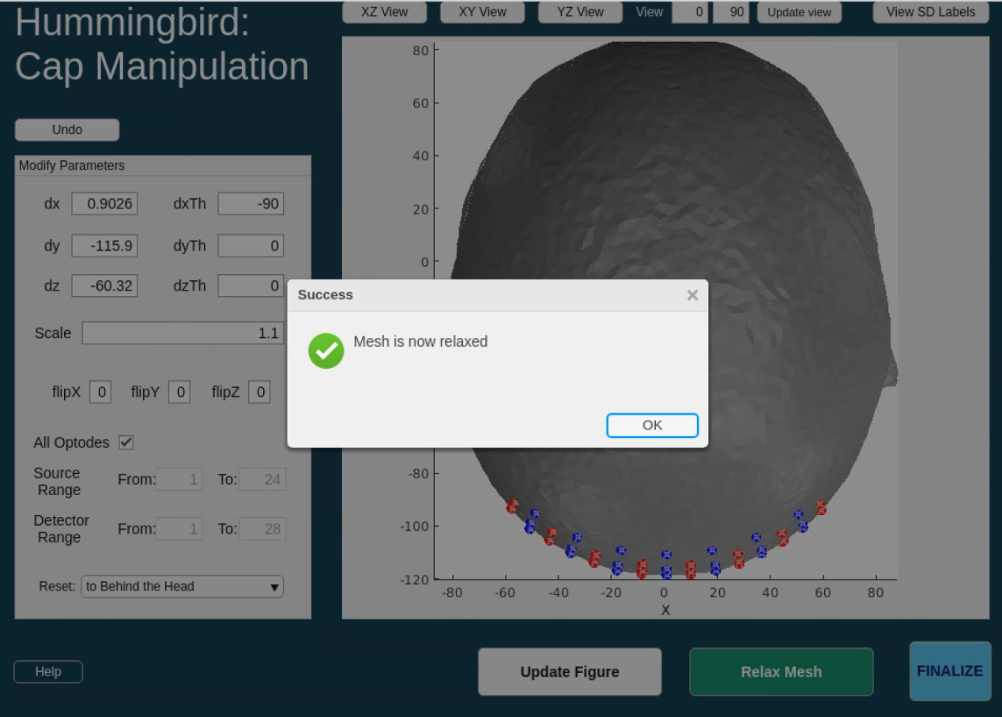
Hummingbird Tutorial 14
Once optodes are relaxed onto the mesh, a dialogue box will show up on the Hummingbird app
Hit “OK” to close it

Slide 30
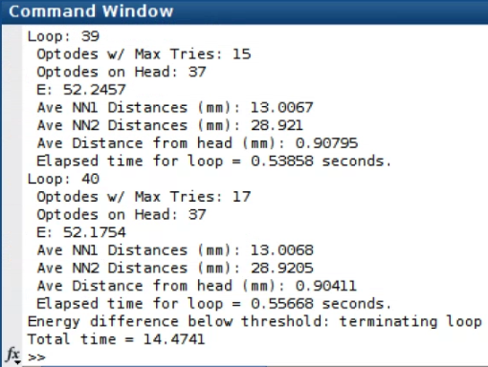
Hummingbird Tutorial 15
To save the new optode locations to your MATLAB workspace, hit the “Finalize” button
This will also close Hummingbird
Note: on some versions of MATLAB, the finalize button will not be visible
Simply close Hummingbird and resume the script at the next line, the relaxed optodes will be saved to the DataStorage object and you will be able to access them
Congrats!! You’ve finished the Hummingbird tutorial!

Slide 31
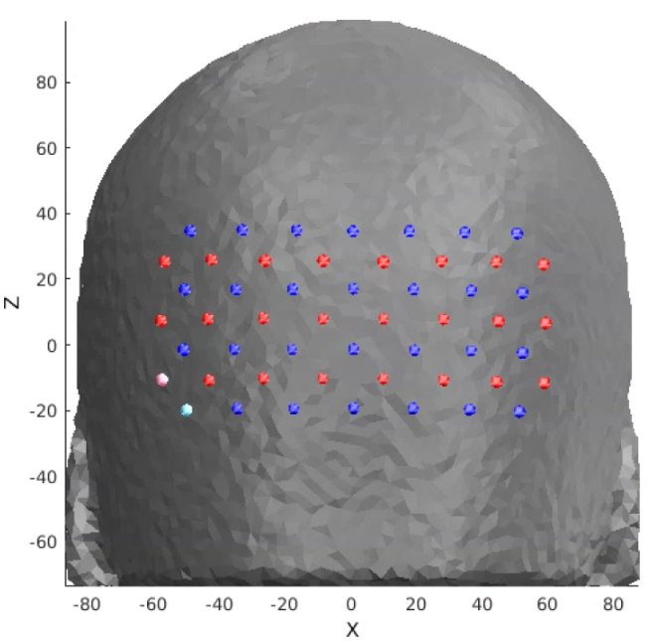
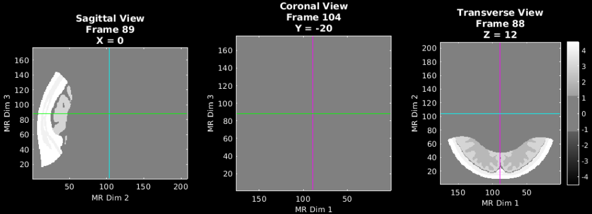
Generate smaller mask based on optode locations
MRI Acquisition
Here, we get our relaxed grid position and visualize it on the LD mesh. Then, we scoop out the part of the mesh that the grid is sitting on. This scooped section will is the basis for the high-density mesh that we are about to create
% get relaxed optode positions from Hummingbird
tposNew = ds.dO.tpos2_relaxed;
% visualize mesh with relaxed optodes
pM.reg=0;
PlotMeshSurface(meshLD,pM);Draw_Foci_191203(tposNew,paramsFoci)
view(0,0)
%% Generate smaller mask based on optode locations
maskCrop=IceCreamScoopCap4Mask(infoT1,tposNew,mask,40); %40 = mm of mesh to scoop out
PlotSlices(maskCrop,infoT1,pS) % visualize smaller mask
Image Segmentation
LD Mesh Generation
Optode Placement
HD Mesh Generation

Slide 32
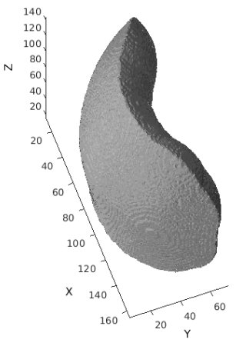
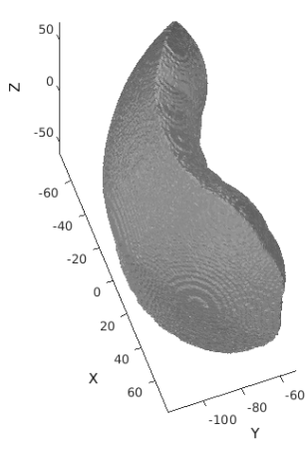
Generate a high-density mesh and visualize
MRI Acquisition
Take the scooped section of the LD mesh and turn it into a HD mesh
% If you get an error when running NirfastMesh_Region,
% try changing the mesh name and then re-run NirfastMesh_Region
meshname=['_HD_Mesh1']; % Provide a name for your mesh name here
param.facet_distance=2.0; % Node position error tolerance at boundary
param.facet_size=0.8; % boundary element size parameter
param.cell_size=1.0; % Volume element size parameter
param.Mode=0; % Set Mode=0 to make nirfast compliant mesh
tic;meshHD=NirfastMesh_Region(maskCrop,meshname,param);toc
%make copy of mesh that only contains nodes and elements for visualization purposes
visMeshHD.nodes = meshHD.nodes;
visMeshHD.elements = meshHD.elements;
PlotMeshSurface(visMeshHD,pM);view([70,60]) %Visualize in index space
% Put coordinates back in coordinate space meshHD.nodes=change_space_coords(meshHD.nodes,infoT1,'coord'); %for actual mesh visMeshHD.nodes=change_space_coords(visMeshHD.nodes,infoT1,'coord'); %for mesh that’s visualized PlotMeshSurface(visMeshHD,pM);view([70,60]) %Visualize in coordinate space
Image Segmentation
LD Mesh Generation
Optode Placement
HD Mesh Generation
“index space”
is non-negative
“coordinate space”
The origin is in the center of volume

Slide 33
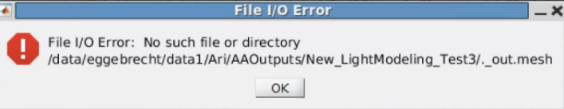
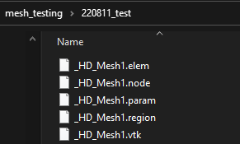
Generate a high-density mesh and visualize
Notes and possible errors
Possible Errors in HD mesh generation
File I/O Error:
Solution: delete all mesh files in your output directory, change the meshname variable to a new name and re-run
Ex: ‘_HD_Mesh1’ → ‘_HD_Mesh0’
Make sure you delete these files from the file manager, and NOT within matlab
If the above doesn’t work, create an entirely new output directory, make that directory your current folder, then re-run lines 149-168
Poor mesh quality
Occurs if number of nodes in mesh is greater than 1,000,000
This is why we make smaller HD meshes and tune params.cell size
Parameters
Cell_size = size of internal tetrahedra
This can be changed to ensure that the number of nodes in the mesh does not exceed 999,999
For HD meshes, this is typically set to 1.0 for visual pad, and 2.0 for larger volume meshes i.e. full head
Facet_distance = error tolerance at boundary for node positions
Typically set to 2.0 for HD meshes
Facet_size = size of surface triangles of mesh
Want to keep this as small as possible, as we want the surface to be highly faceted
Typically set to 0.8 for HD meshes
Pop-up box for File I/O Error
Files to delete if File I/O Error occurs

Slide 34
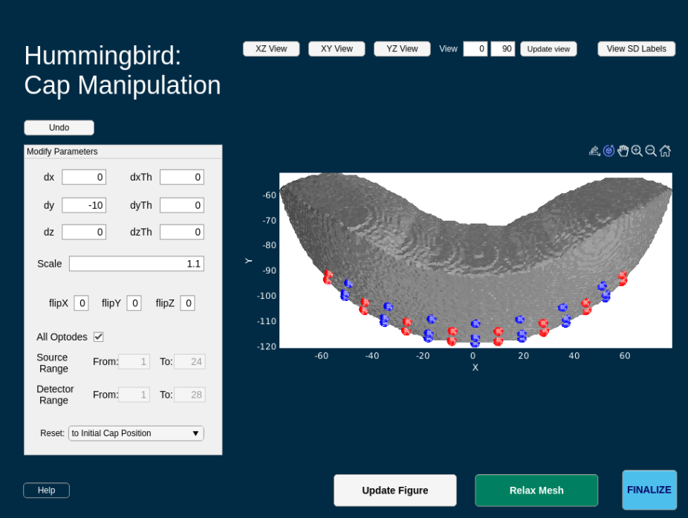
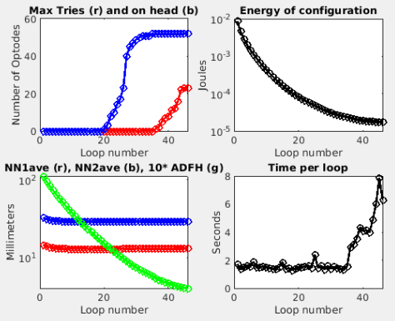
Place the optodes on the HD mesh
MRI Acquisition
This time, since the HD mesh is in the same space that the LD mesh was, the grid will already be lined up and sitting on the mesh when hummingbird starts. You’ll need to move it away from the mesh and re-relax the grid back onto the mesh
Change the view to “XY View”
Move the grid off the mesh by setting dy = -10
Adjust the scale to 1.1 (this is the scale we used for the LD mesh too)
Hit “Update Figure”
Hummingbird’s GUI should now look like the image below
Hit “Relax Mesh” and “Finalize” after the grid has been re-relaxed onto the mesh
Image Segmentation
LD Mesh Generation
Optode Placement
% get relaxed optode positions from Hummingbird
% input structure
ds_HD = DataStorage();
ds_HD.dI.tpos = tposNew;
ds_HD.dI.mesh = visMeshHD;
ds_HD.dI.pM = pM;
ds_HD.dI.paramsFoci = paramsFoci;
ds_HD.dI.Ns = Ns;
ds_HD.dI.rad = rad;
% run hummingbird
myapp=Hummingbird(ds_HD);
while isvalid(myapp);pause(0.1);end
HD Mesh Generation
Optode Placement

Slide 35
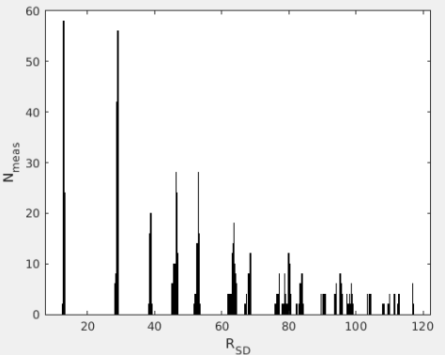
Update pad info structure after running Hummingbird
After the pad has been relaxed onto the HD mesh, we need to update the info structure with the new optode locations
info.optodes.spos3=tposNew_HD(1:Ns,:);
info.optodes.dpos3=tposNew_HD((Ns+1):end,:);
m=0;
for d=1:Nd
for s=1:Ns
m=m+1;
info.pairs.r3d(m)=norm(tposNew_HD(s,:)-tposNew_HD(d+Ns,:));
info.pairs.r3d(m+(Ns*Nd))=info.pairs.r3d(m);
end
end
% histogram of number of measurements per SD vs radius between SD pairs figure;histogram(info.pairs.r3d,1000);xlabel('R_S_D');ylabel('N_m_e_a_s');
% save pad file
gridname=padname;
save(['Pad_',meshname,'_',gridname,'_', '.mat'],'info')
MRI Acquisition
Image Segmentation
Mesh Generation
For both LD and HD meshes
Optode Placement

Slide 36
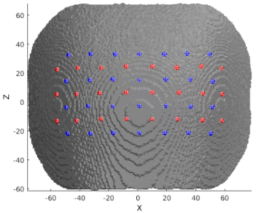
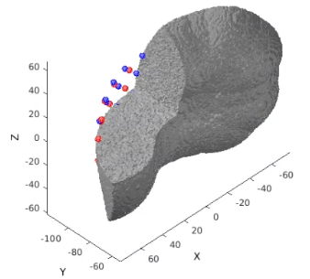
Calculate the sensitivity (1 of 3)
Prepare mesh and optode information for NIRFAST, then visualize
gridname=padname;
mesh=PrepareMeshForNIRFAST(mesh,[meshname,'_',gridname],tposNew);
PlotMeshSurface(mesh,pM);Draw_Foci_191203(tposNew_HD, paramsFoci);
view([0,0]) %posterior view
MRI Acquisition
236.
237.
238.
239.
245.
246.
247.
248.
249.
Image Segmentation
Visualize cap and mesh with portion cut out to make extra sure that optodes are not placed too far within the mesh
Mesh Generation
For both LD and HD meshes
m3=CutMesh(mesh,intersect(find(mesh.nodes(:,3)>0),find(mesh.nodes(:,1)>0)));
[Ia,Ib]=ismember(m3.nodes,mesh.nodes,'rows');Ib(Ib==0)=[];
m3.region=mesh.region(Ib);
PlotMeshSurface(m3,pM);Draw_Foci_191203(tposNew_HD, paramsFoci);
view([135,40]) %view mesh from behind with an angled top-down view
Optode Placement
Calculate Sensitivity
1.
2.

Slide 37
Calculate the sensitivity (2 of 3)
3. Set parameters for light modeling
flags.tag=[padname,'_on_',meshname,'_test'];
flags.gridname=gridname;
flags.meshname=meshname;
flags.head='info';
flags.info=infoT1;
flags.gthresh=1e-5;
flags.voxmm=2;
flags.labels.r1='csf';
flags.labels.r2='white';
flags.labels.r3='gray';
flags.labels.r4='bone';
flags.labels.r5='skin';
flags.op.lambda=[750,850];
flags.op.mua_skin=[0.0170,0.0190];
flags.op.mua_bone=[0.0116,0.0139];
flags.op.mua_csf=[0.0040,0.0040];
flags.op.mua_gray=[0.0180,0.0192];
flags.op.mua_white=[0.0167,0.0208];
flags.op.musp_skin=[0.74,0.64];
flags.op.musp_bone=[0.94,0.84];
flags.op.musp_csf=[0.3,0.3];
flags.op.musp_gray=[0.8359,0.6726];
flags.op.musp_white=[1.1908,1.0107];
flags.op.n_skin=[1.4,1.4];
flags.op.n_bone=[1.4,1.4];
flags.op.n_csf=[1.4,1.4];
flags.op.n_gray=[1.4,1.4];
flags.op.n_white=[1.4,1.4];
flags.srcnum=Ns;
flags.t4=affine_Subj2MNI;
flags.t4_target='MNI'; % string
flags.makeA=1; % don't make A, just make G
flags.Hz=0;
if flags.Hz, flags.tag = [flags.tag,'FD']; end
MRI Acquisition
255.
256.
257.
258.
259.
260.
261.
262.
263.
264.
265.
266.
267.
268.
269.
270.
271.
272.
273.
274.
275.
276.
277.
278.
279.
280.
281.
282.
283.
284.
285.
286.
287.
288.
Voxelation resolution
Image Segmentation
Region labels
Mesh Generation
For both LD and HD meshes
Absorption Coefficients for regions
Optode Placement
Scattering Coefficients for regions
Calculate Sensitivity
Index of refraction for regions

Slide 38
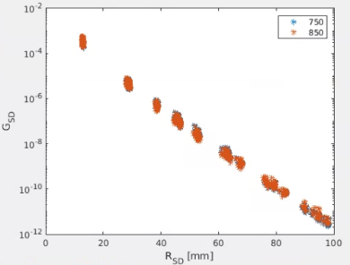
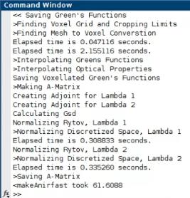
Calculate the sensitivity (3 of 3)
4. Calculate Green’s functions, voxelate, create sensitivity matrix, adjust bookkeeping
Ti=tic;[A,dim,Gsd]=makeAnirfaster(mesh,flags); % size(A)= [Nwl, Nmeas, Nvox]
disp(['<makeAnirfast took ',num2str(toc(Ti))])
%Gsd vs Rsd provides a simulated light fall-off figure;semilogy(info.pairs.r3d(1:(Ns*Nd)),Gsd,'*');
legend({num2str(flags.op.lambda')})
xlabel('R_S_D [mm]');ylabel('G_S_D');xlim([0,100])
MRI Acquisition
291.
292.
294.
295.
296.
297.
Image Segmentation
Mesh Generation
For both LD and HD meshes
If makeAnirfaster is successful, output like the below screenshot should show up in your command window
Optode Placement
Calculate Sensitivity

Slide 39
Package Sensitivity Matrix with associated info
5. Arrange A to have the same measurement list structure as the data:
[Nwl,Nmeas,Nvox]=size(A);
A=reshape(permute(A,[2,1,3]),Nwl*Nmeas,Nvox);
6. Place spatial information about light model in info.tissue structure:
info.tissue.dim=dim;
info.tissue.affine=flags.t4;
info.tissue.infoT1=infoT1;
info.tissue.affine_target='MNI';
info.tissue.flags=flags;
temp_pairs=struct;
temp_pairs.Src=info.pairs.Src;
temp_pairs.Det=info.pairs.Det;
temp_pairs.NN=info.pairs.NN;
temp_pairs.WL=info.pairs.WL;
temp_pairs.lambda=info.pairs.lambda;
temp_pairs.Mod=info.pairs.Mod;
temp_pairs.r2d=info.pairs.r2d;
temp_pairs.r3d=info.pairs.r3d;
info.pairs=temp_pairs;
save(['A_',flags.tag,'.mat'],'A','info','-v7.3’)
MRI Acquisition
Image Segmentation
Mesh Generation
For both LD and HD meshes
Optode Placement
Calculate Sensitivity

Slide 40
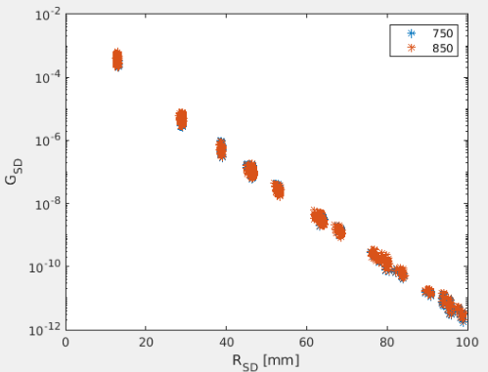
Package Sensitivity Matrix with associated info
6. Package and save A where all source-detector separations are less than 6cm
For high-density pads, only measurements from source-detector (SD) pairs that have a separation distance within 6cm are generally used. These overlapping measurements are what provide the image quality of the HD arrays. The Gsd vs Rsd scatterplot is a helpful tool for visualizing what measurements meet the 6cm cutoff. A red box has been placed around the measurements within the 6cm cutoff.
% Get A with all SD separations within 6cm
keep=info.pairs.r3d<=60;
temp=struct;
temp.Src=info.pairs.Src(keep);
temp.Det=info.pairs.Det(keep);
temp.NN=info.pairs.NN(keep);
temp.WL=info.pairs.WL(keep);
temp.lambda=info.pairs.lambda(keep);
temp.Mod=info.pairs.Mod(keep);
temp.r2d=info.pairs.r2d(keep);
temp.r3d=info.pairs.r3d(keep);
info.pairs=temp;
A=A(keep,:); %A with all SD within 6cm
save(['A_r3d_lth_60_',flags.tag,'.mat'],'A','info','-v7.3') %save A with all SD within 6cm
MRI Acquisition
Image Segmentation
Mesh Generation
Gsd vs Rsd
For both LD and HD meshes
Optode Placement
Calculate Sensitivity

Slide 41
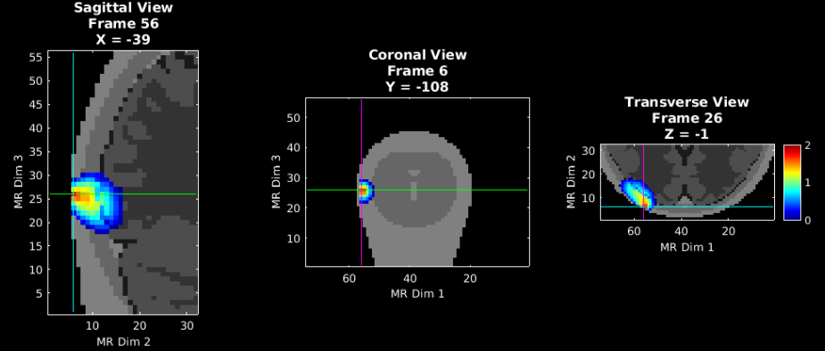
Validate the sensitivity (1 of 2)
Visualize an example measurement’s sensitivity using the A matrix containing measurements from SD’s with separations < 6cm. We’ll start with a single source detector pair, and visualize the full sensitivity profile (FFR) on the next slide.
% Visualize aspects of sensitivity profile
t1=affine3d_img(mask,infoT1,dim,eye(4)); % put anatomical volume in dim space
keep=info.pairs.WL==2 & info.pairs.Src==1 & info.pairs.Det==6;
foo=squeeze(A(keep,:)); % Single meas pair
fooV=Good_Vox2vol(foo',dim);
fooV=fooV./max(fooV(:));
fooV=log10(1e2.*fooV); % top 2 o.o.m.
pA.PD=1;pA.Scale=2;pA.Th.P=0;pA.Th.N=-pA.Th.P;
PlotSlices(t1,dim,pA,fooV)
MRI Acquisition
Image Segmentation
Mesh Generation
For both LD and HD meshes
Optode Placement
Single SD pair: source 1 detector 6
Calculate Sensitivity
Validate Sensitivity

Slide 42
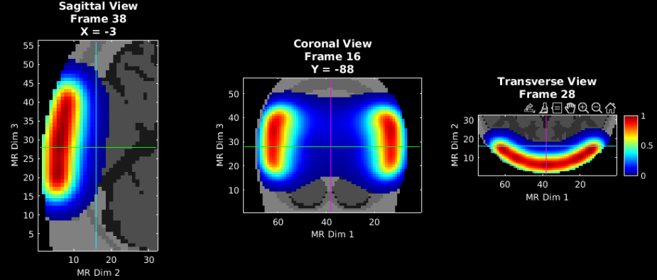
Validate the sensitivity (2 of 2)
Visualize the flat field reconstruction
keep=(info.pairs.WL==2 & info.pairs.r2d<=40);
a=squeeze(A(keep,:));
iA=Tikhonov_invert_Amat(a,0.01,0.1);
iA=smooth_Amat(iA,dim,5); % use smoothing parameter of 5 here
ffr=makeFlatFieldRecon(a,iA);
fooV=Good_Vox2vol(ffr,dim);
fooV=fooV./max(fooV(:));
pA.PD=1;pA.Scale=1;pA.Th.P=1e-2;pA.Th.N=-pA.Th.P;
PlotSlices(t1,dim,pA,fooV)
MRI Acquisition
Image Segmentation
Mesh Generation
For both LD and HD meshes
Optode Placement
Calculate Sensitivity
Validate Sensitivity

Slide 43
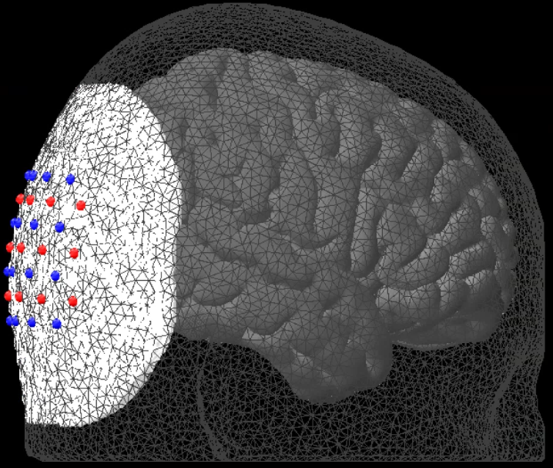
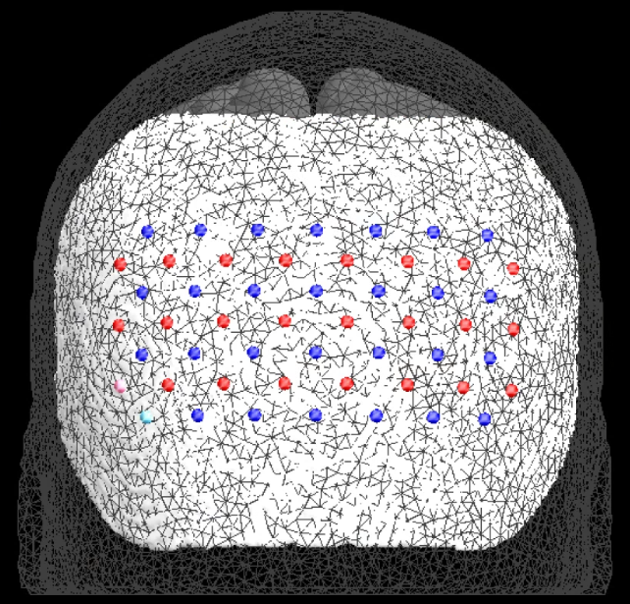
Put it all together
As a final check, let’s visualize the alignment of the LD mesh, HD mesh, optode array, and cortical meshes all together
% View alignment
Cortical_mesh = load(['MNI164k_big.mat']);
Anat.CtxL = Cortical_mesh.MNIl;
Anat.CtxR = Cortical_mesh.MNIr;
pA0l=struct;
figure('Color','k','Position',[500,100,1050,1000])
pM1.fig_handle=gca;pM1.FaceColor=[1,1,1].*0.5;
pM1.SpecularStrength=0.25;pM1.DiffuseStrength=0.5;
PlotMeshSurface(meshHD,pM1) % HD mesh
pA0l.fig_handle=gca;
pA0l.FaceColor=[1,1,1].*0.5;pA0l.EdgeColor='none';
pA0l.AmbientStrength=0.25;pA0l.DiffuseStrength=0.25;
pA0l.SpecularStrength=0.025;
PlotMeshSurface(Anat.CtxL,pA0l) % Cortical Surfaces
PlotMeshSurface(Anat.CtxR,pA0l)
pA2.fig_handle=gca;
pA2.FaceAlpha=0;
pA2.EdgeAlpha=0.5;
pA2.EdgeColor=[1,1,1].*0.25;
PlotMeshSurface(meshLD,pA2) % LD mesh
set(gca,'Color','k')
view([90,0]) % display in lateral view
Draw_Foci_191203(cat(1,info.optodes.spos3,info.optodes.dpos3),paramsFoci) % Array
axis off
% For posterior view uncomment the following line
% view([0,0])

Slide 44
Help Expand NeuroDOT’s Utility!
Please fill out the NeuroDOT registration form to help us better develop the NeuroDOT toolbox and expand its utility to address your fNIRS/DOT data analysis needs:
https://forms.gle/8QNGnx7ZbKuUHg3bA
Additionally, please provide specific feedback, or ask questions to the development team:
https://forms.gle/jv6RkX5s784LgQC89
Note: you will not be contacted by the NeuroDOT development team unless you opt-in to receiving communications.

Slide 45
That’s It (For Now)
Congratulations! You have finished the NeuroDOT Light Modeling Pipeline Tutorial for the basic 24x28 visual pad using Hummingbird.
See other Sample Results Appendices for example visualizations of these same processing steps on the other Sample Data included in the toolbox.
Also, see the PreProcessing and Reconstruction tutorials to gain a deeper understanding of the effects of altering the processing parameters.
NeuroDOT Support: neurodot-support@wustl.edu

